Slide 1
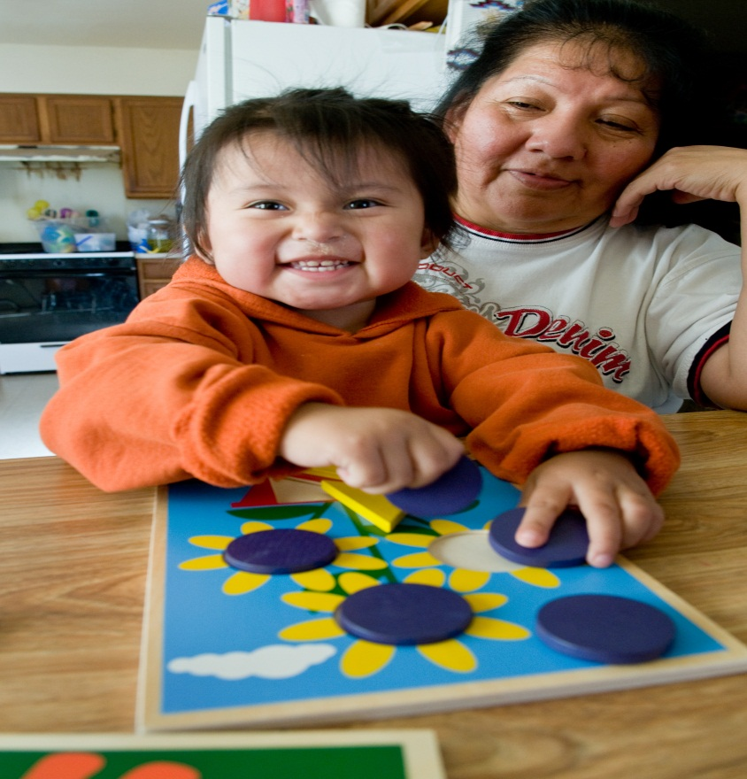
Working with Parents of Second-Language Learners
WETA Reading Rockets Webinar Series
October 25, 2012
Judith Jerald, Senior Early Childhood Advisor
U.S. Programs

Slide 2
Working with ParentsOveraOOO
Building strong, respectful collaborations
with parents supports the healthy development of their babies, toddlers, and preschoolers, and contributes to the creation of culturally diverse communities where all children can learn, grow, and thrive.
Early Steps to School Success/Dual Language Learning Curriculum/ Zero to Three/Save the Children

Slide 3
Principles to Remember
Language is learned in the context of relationships
Language and culture are linked
Parents should be encouraged to use the language in which they are most competent
Early childhood educators should know about dual language acquisition, the culture of the children they serve, and the developmental stages that children learning two languages may go through.

Slide 4
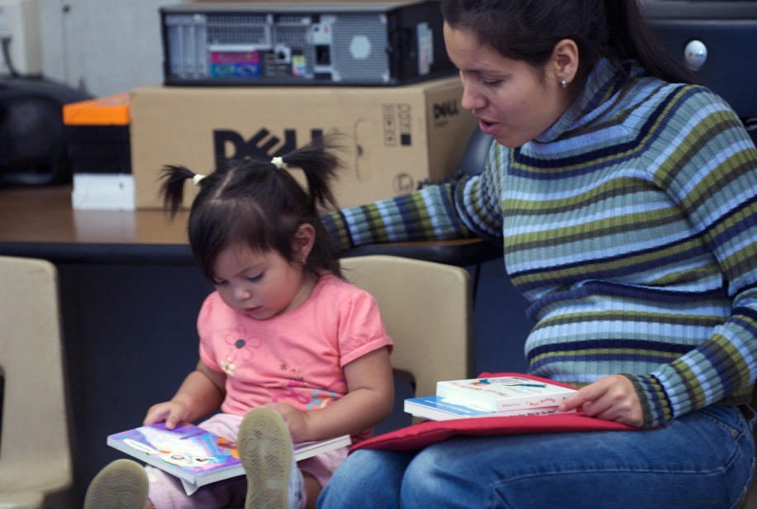
The Importance of Home Language
Shapes a child’s self-concept
Affects a child’s ability to participate in his family’s culture
Opens up multiple opportunities in life

Slide 5
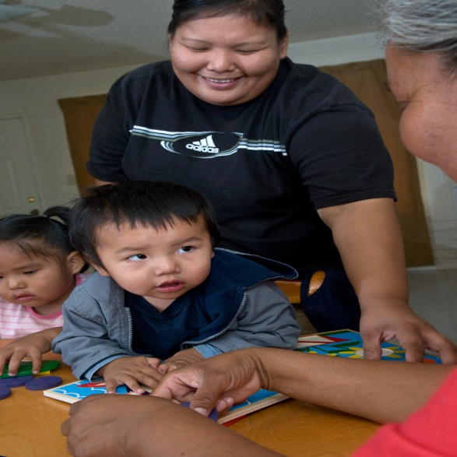
What We Can Tell Parents About Young Children Learning Two Languages
Simultaneous bilinguals
Language Mixing
Peer relationships are important in learning a second language
Silent Period
Reading
Myths

Slide 6
Strategies for Parent Groups
Incorporate home language and culture
Include community members from families’ home culture(s).
Modify activities
Provide information in families’ home languages
Demonstrating a talent or skill

Slide 7
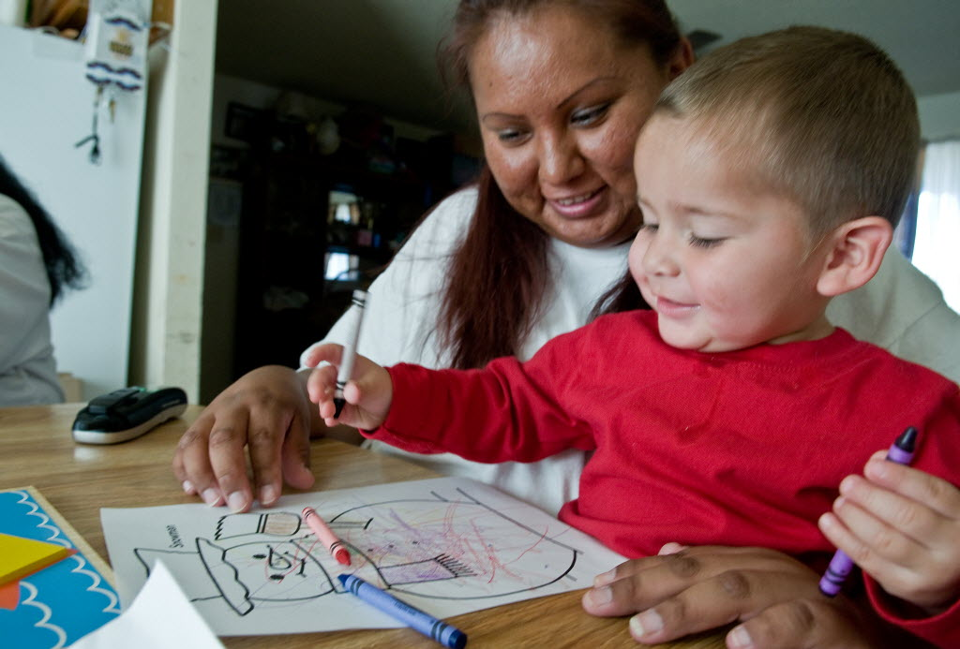
Visiting with Parents
Prepare
Engage
Developing Literacy
Social Emotional Development

Slide 8
Lessons Learned
Staffing: What to look for when hiring staff who will work with parents of second language learners
Environment
Transitions of children to public school and other settings
Community
Rural settings
Children with
disabilities

Slide 9
Lessons From the Field
“Families are more comfortable with their home visitor if she speaks their native tongue—families will share more about their experiences, risks and resources”.
“We have found that we have more turnover of families when the home visitor doesn’t speak their language”.
“Preschool and kindergarten teachers are sharing with us that they can tell who the ESSS children are because of the parent engagement. Those families stand out from the others and feel comfortable in the school setting”. ESSS Program Specialist from central CA

Slide 10
References and Resources
Much of the material for this presentation came from the following resources:
Zero To Three. (Nov. 2008). Dual Language Learners in Early Care and Education Setting, Washington, DC: Author.
Zero to Three and Save the Children. (2007). Early Steps to School Success/An Introduction to Dual Language Learning. Curriculum author Rebecca Parlakian
Tabors, P.O. One Child Two Languages (1997). Baltimore: Brooks.
National Association for the Education of Young Children. (1995). Responding to linguistic and cultural diversity: Recommendations for effective early childhood education. Washington, DC: Author.
Stacey York. ( (2003)Roots and Wings: Affirming Culture in Early childhood Programs, St Paul, MN: Redleaf Press.
Gonzalez-Mena, Janet (2005). Diversity in early care and education programs: honoring differences. Boston: McGraw-Hill.

